Slide 1



CyberShield AI
AI-BasedCyber Security Threats Prediction Platform
@Prathamzodape.
Transforming cybersecurity operations with AI-powered threat detection
Secure Connection
AI-Powered Protection
Real-time Analysis
Notes:
1

Slide 2









The Challenge:
Overwhelming Security Data
Security teams face a constant, high-velocity stream of sophisticated cyber threats, making manual analysis impractical.
Sophisticated Threats
Massive Log Volumes
Tool Fragmentation
Advanced malware, zero-day exploits, and APTs constantly evolve, outpacing traditional detection methods.
Security teams struggle to manually sift through terabytes of logs to identify genuine, critical alerts.
Lack of a single, integrated tool for real-time monitoring, deep analysis, and predictive intelligence.
@Prathamzodape.
Security Alert Overload
Need: An AI-powered unified platform to transform chaos into actionable intelligence
2 / 12
Notes:
2

Slide 3














Our Solution:
An AI-Powered, Unified Platform
Real-time Monitoring
Security Helper
Live dashboards with at-a-glance metrics
Instantly explains threats and action steps in simple terms.
Dashboard
ML-Powered Prediction
Rule-Based Chatbot
@Prathamzodape.
A centralized " Cyber Threat Dashboard" provides a single pane of glass for all security events, showing blocked attacks and critical alerts.
Leverages Machine Learning (Random Forest) to predict and classify threats automatically, enabling proactive defense.
Integrates a 'Security Helper' chatbot to provide instant, rule-based answers to common security questions and guide users.
Outcome: Empowers analysts to move from reactive defense to proactive threat hunting
3 / 12
Notes:
3

Slide 4







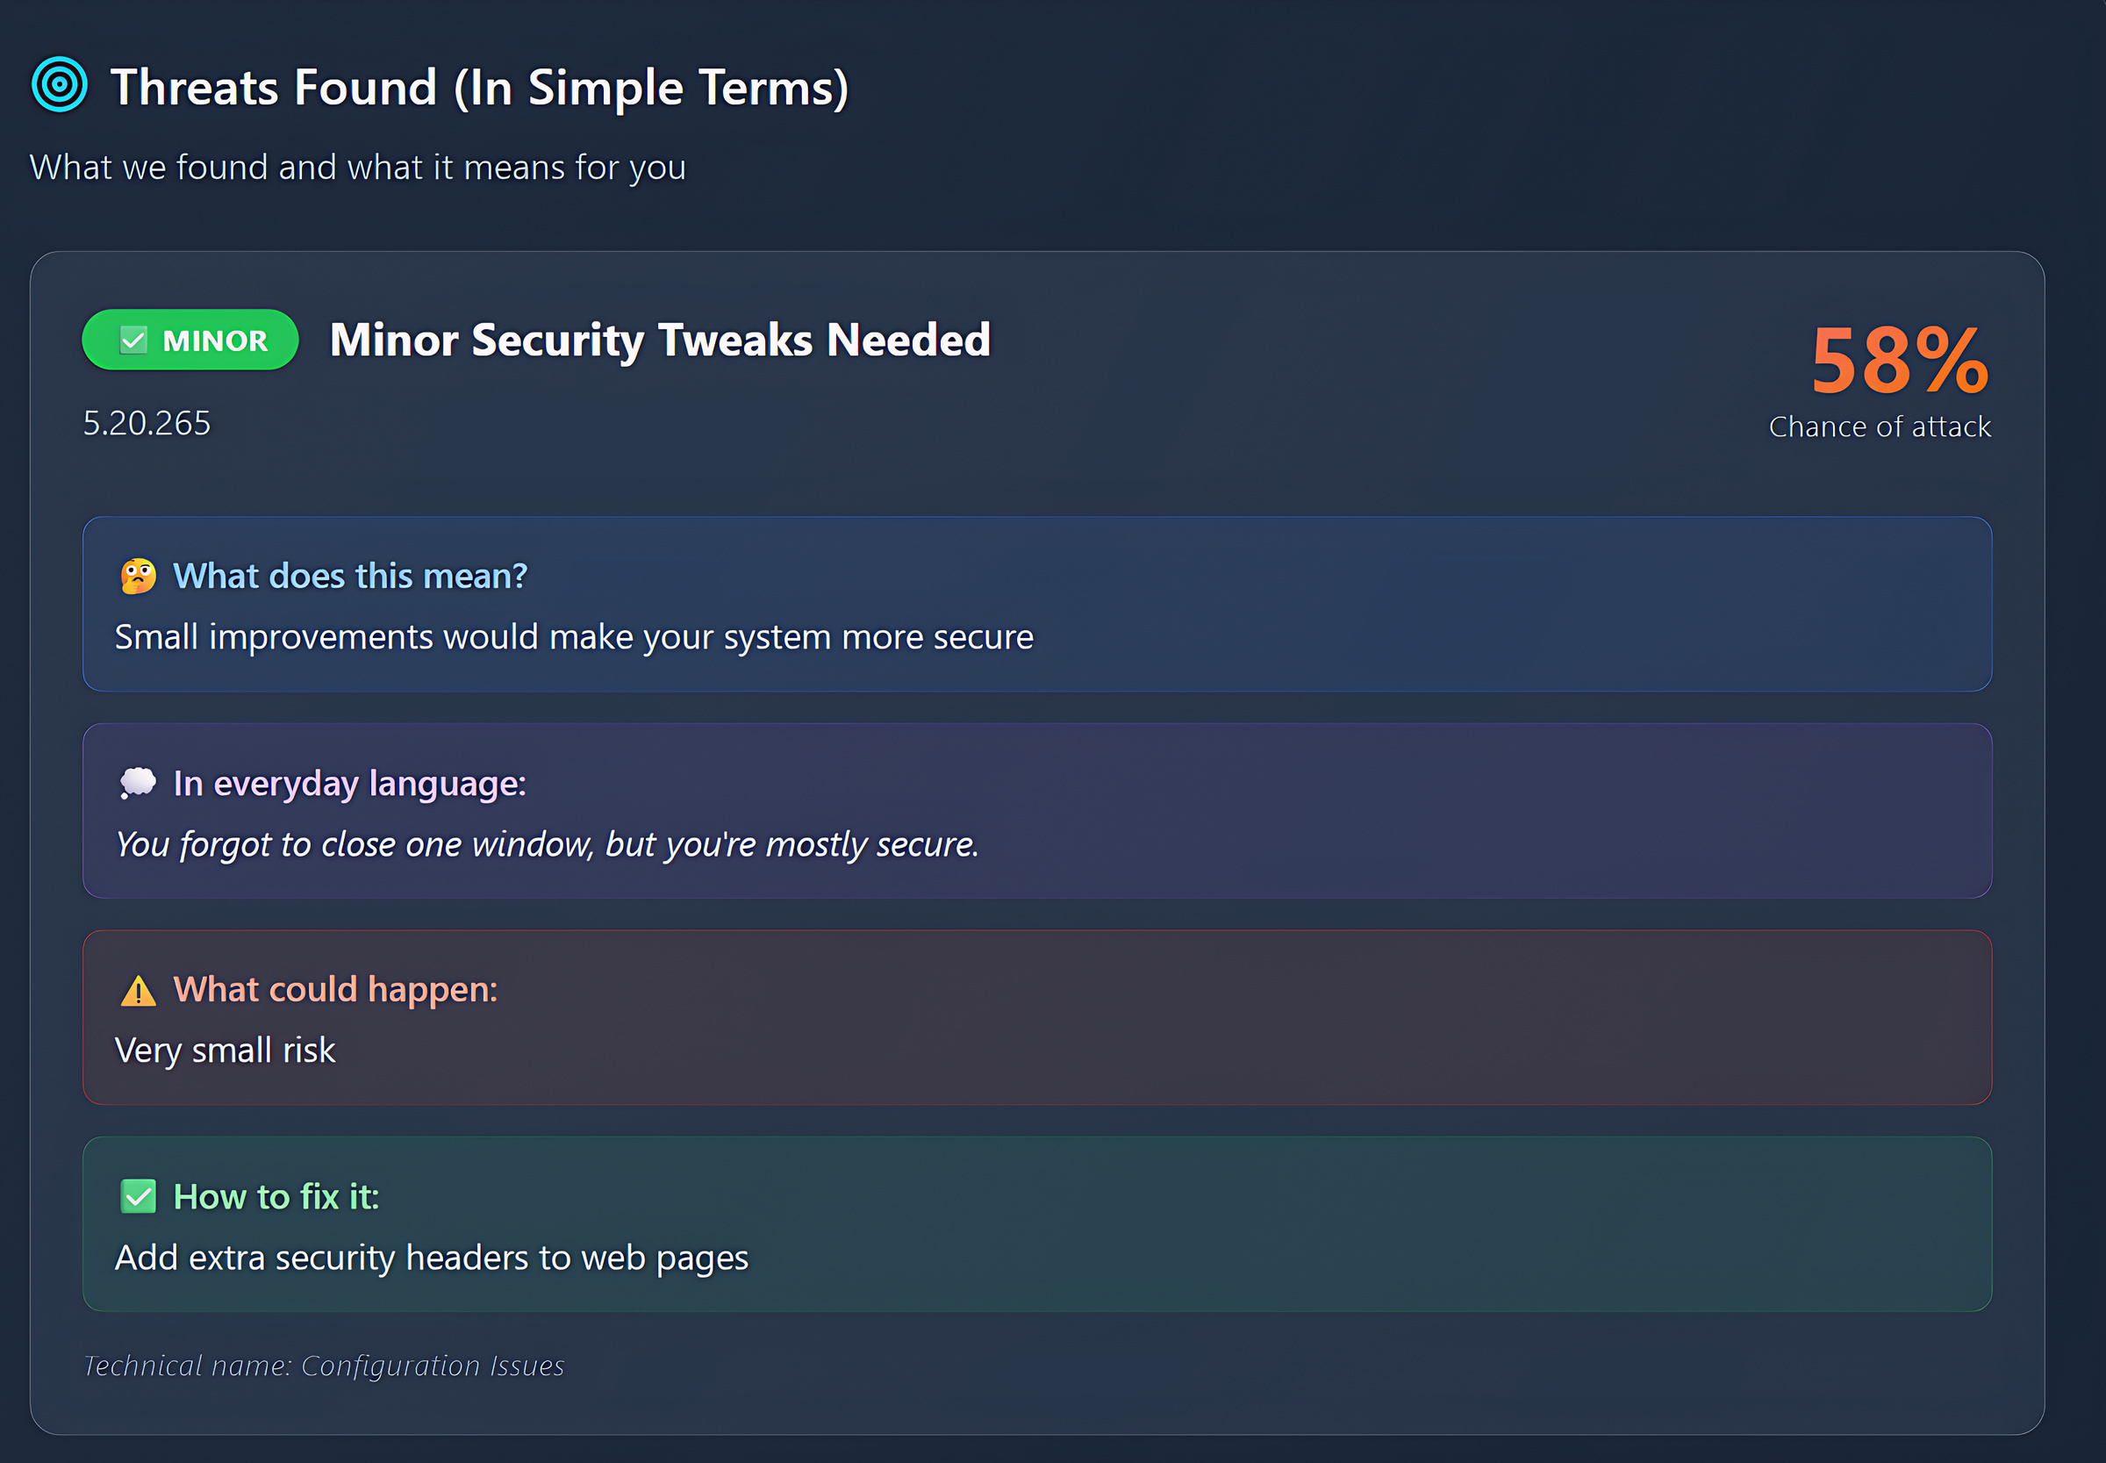

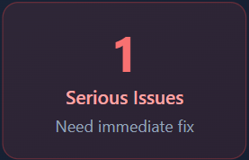
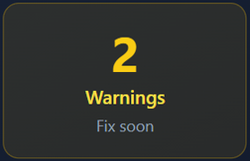


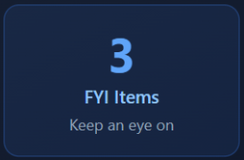
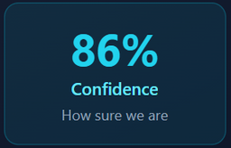


Key Feature:
Live Dashboard & AI Core
A unified platform providing real-time insights and AI-powered analysis.
Unified Dashboard
Live Event Feeds
Security Helper (Chatbot)
At-a-glance metrics for security events with live-updating charts.
Auto-refreshing tables for real-time threat intelligence.
Conversational AI that understands dashboard context for quick insights.
Chat with AI Agent
BOT- Hello! How can I help?
USER - is this dangerous?
@Prathamzodape.
BOT - Good news! You don't have any critical threats right now...
Key Benefit: Transform complex security data into actionable intelligence
4 / 12
Notes:
4

Slide 5


















Key Feature:
Analysis & ML Training
Advanced analysis tools transform raw security data into actionable intelligence.
Monitor Website
Offline Dataset Analysis
Clear, Actionable Steps
Test security weaknesses of specific API endpoints or live websites.
Upload historical log files for comprehensive analysis with geo-threat mapping.
Provides a prioritized action plan to help users fix detected vulnerabilities.
Example file:
threat_data.csv
Example:
86%
Model:
Action Plan
MEDIUM risk
....
Loading
@Prathamzodape.
Data Collection
Analysis
ML Training
Enhanced Protection
Key Benefit: Transform raw security data into actionable intelligence
5 / 12
Notes:
5

Slide 6











Technology Stack
&
System Architecture
Our AI & ML-based cybersecurity platform leverages modern technologies for comprehensive threat detection and analysis.
Frontend & Visualization
Data Science & ML
Vercel - Frontend Hosting & Deployment
Pandas & NumPy - Data manipulation
Plotly - Interactive data visualization
Scikit-learn - ML algorithms
Joblib - Parallel computing & LightGBM - Gradient Boosting Framework
Database
AI & System
@Prathamzodape.
PostgreSQL - Production environment
Rule-Based Chatbot - Security Helper
SQLite - Local development
psutil - System monitoring
Architecture: Built with Python 3.11 using Vercel framework,
enabling real-time threat analysis and prediction
6 / 12
Notes:
6

Slide 7










AI/ML Model
Performance
Our cybersecurity platform leverages machine learning to classify network traffic as benign or malicious.
Random Forest Classifier
Logistic Regression
An ensemble learning method that operates multiple decision trees for improved accuracy.
A statistical model that predicts traffic as benign or malicious based on learned patterns.
Robust against overfitting
Fast training and prediction
Classification Task
Key Metrics
@Prathamzodape.
Models classify network traffic as 'Benign' or 'Malicious' (e.g., 'DDoS', 'Keylogger').
Accuracy: High classification precision
Precision: Reliable positive predictions
Recall: Comprehensive threat detection
F1-Score: Balanced precision-recall
Accuracy
Precision
Recall
F1-Score
High
High
High
High
7 / 12
Notes:
7

Slide 8













Revolutionary
Advantages & Impact
Our AI-powered platform transforms cybersecurity operations, enabling analysts to move from reactive defense to proactive threat hunting.
Traditional Security
AI Transformation
AI-Powered Security
Reactive, manual analysis
Proactive, intelligent defense
Democratizing Security Analysis
Moving to Proactive Defense
The AI and UI do the heavy lifting, enabling non-data scientists to find insights without complex queries.
Instead of just logging threats, our system predicts them, transforming security from reactive to proactive.
@Prathamzodape.
Unified Security Platform
AI-Powered Insights
Single tool for monitoring, investigation, and training—no more switching between 5 different apps.
The 'Security Helper' chatbot provides immediate, simple explanations for complex threats. Analysts can ask 'What does this mean?' or 'How do I fix this?' to get scannable guidance.
Impact: Transforming raw security data into actionable intelligence,
empowering security teams to act proactively
8 / 12
Notes:
8

Slide 9




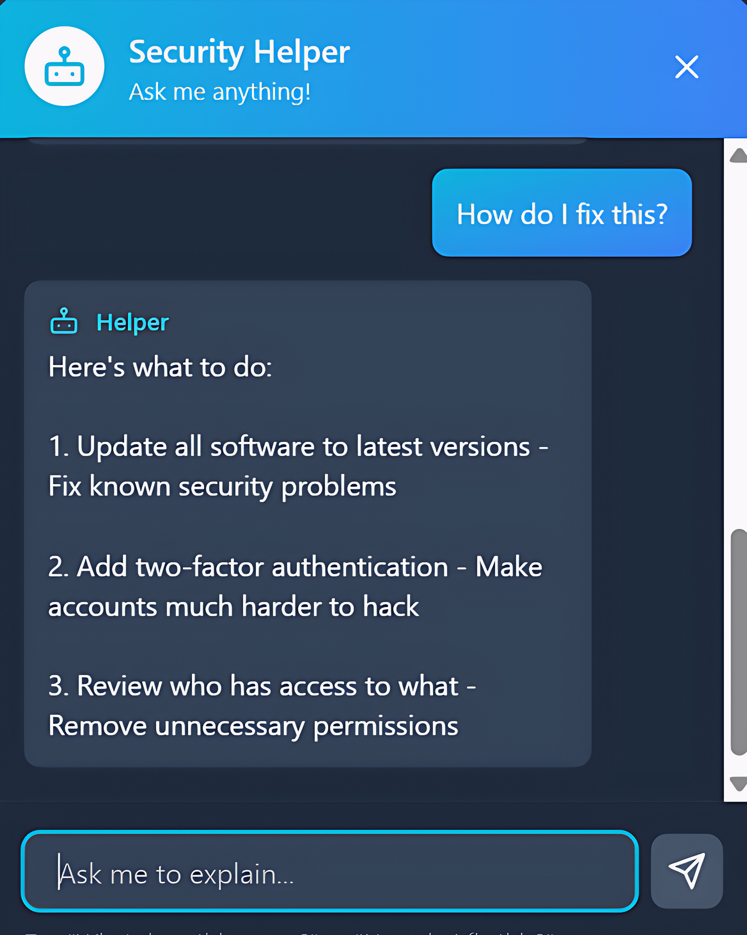





Project in Action:
Live Dashboard Demo
Cyber Threat Dashboard
Security Helper" Chat Picture
Security Score by Category
How well protected you are in each area (0-100)
🔐
Encryption & Privacy
Natural Language
45
/
100
Login & Authentication
40
/
100
Data Synthesis
💾
Data Protection
@Prathamzodape.
42
/
100
🌐
Network Security
Real-time Insights
38
/
100
Overall Security Score
45
/
100
Real-time monitoring active
Key Benefit: Real-time analysis provides a simple, color-coded threat level, a 'Risk Over Time' forecast, and an AI-powered helper to explain it all.
9 / 12
Notes:
9

Slide 10









Project in Action:
Analysis & Training Features
Experience the platform's practical capabilities for threat analysis and model adaptation.
API & Website Scanning
Offline Analysis
Prioritized Action Plan
Real-time threat intelligence for IP addresses.
Upload historical data for comprehensive analysis.
Retrain models with new data to improve detection.
IP Scanner
192.168.125.58
threat_data.csv
Random Forest Model
Investigating:
Risk Level:
MODERATE
Size:
342.6 KB
Status:
Training...
Scans against VirusTotal & AbuseIPDB
Result:
Complete!
@Prathamzodape.
Instant risk assessment
Admin panel for model retraining
Adapts to new threat patterns
Upload .csv files for analysis
Interactive geo-threat map
Key Benefit: System adaptability through continuous learning and human-in-the-loop validation
10 / 12
Notes:
10

Slide 11
















Challenges &
Future Roadmap
Current Challenges
Future Enhancements
API Integration
Deep Learning Models
Integrating and normalizing data from multiple, asynchronous third-party APIs (VirusTotal) into one seamless UI.
Integrating LSTM models for time-series prediction to anticipate threat patterns.
Backend Optimization
Authentication & RBAC
Optimizing the backend to handle large offline dataset uploads without timing out.
Adding full user authentication and role-based access control for enhanced security.
@Prathamzodape.
Data Consistency
Gemini API Integration
Ensuring consistent data formatting and reliability across different security tools and threat intelligence sources.
Gemini API Integration: Upgrade the chatbot to a full generative AI agent.
Development Timeline
Current
S1
M1
L1
Integration
Auth & RBAC
Deep Learning
Alerting
11 / 12
Notes:
11

Slide 12








Conclusion & Impact
Our integrated AI-driven cybersecurity platform successfully transforms raw security data into actionable intelligence, empowering security teams to operate proactively.
Enhanced Protection
AI-Driven Intelligence
Proactive Security
Our platform combines real-time monitoring with powerful predictive ML and interactive analysis tools to create a comprehensive defense ecosystem.
Our platform provides AI-driven reports and a 'Security Helper' to transform complex security data into simple, actionable intelligence.
Moving from reactive defense to proactive threat hunting, our platform enables security teams to stay ahead of evolving threats.
@Prathamzodape.
Integrated
Real-time
Adaptive
Unified platform for monitoring, investigation, and training
Live threat feeds and alert panel for immediate response
Custom ML models that learn and improve over time
Thank You
12 / 12
Notes:
12

